Slide 1


GRADE 5
UNIT TWO
Our vacation
Lesson 5

Slide 2
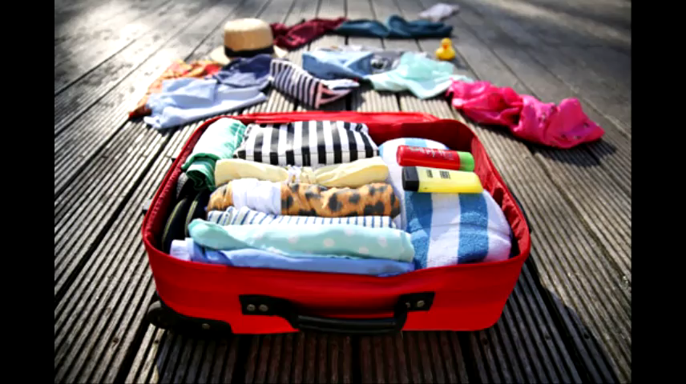

Slide 3
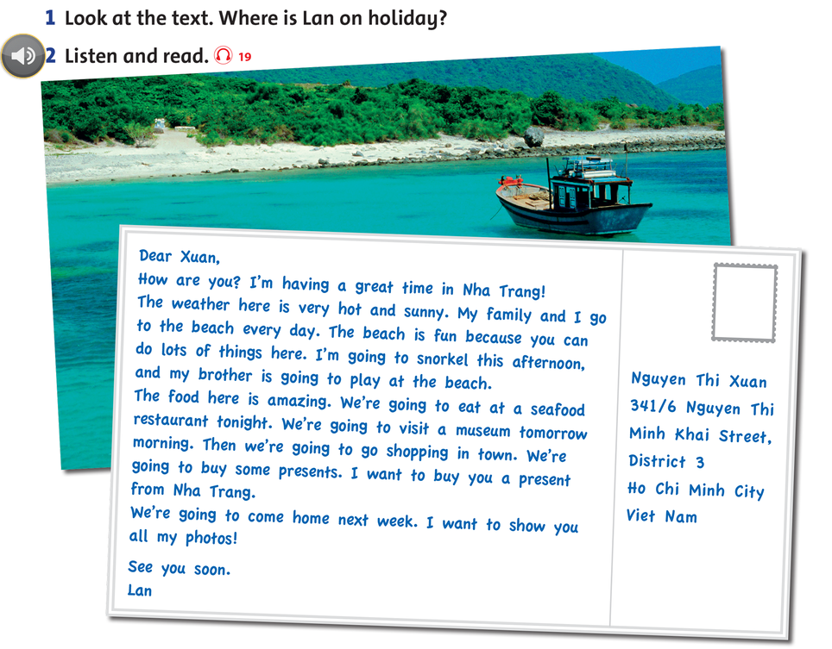

Slide 4

LISTEN AND POINT

Slide 5


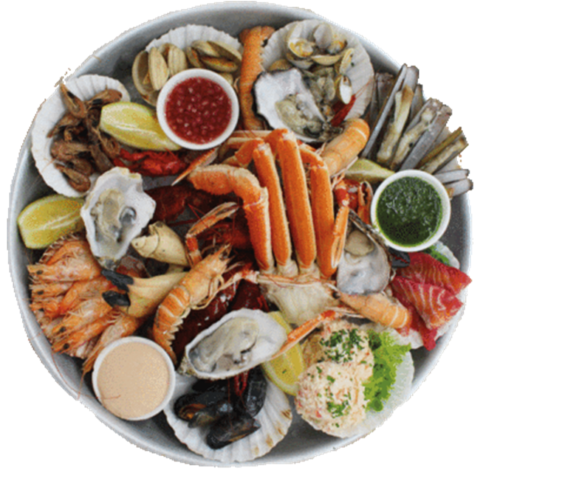
seafood

Slide 6
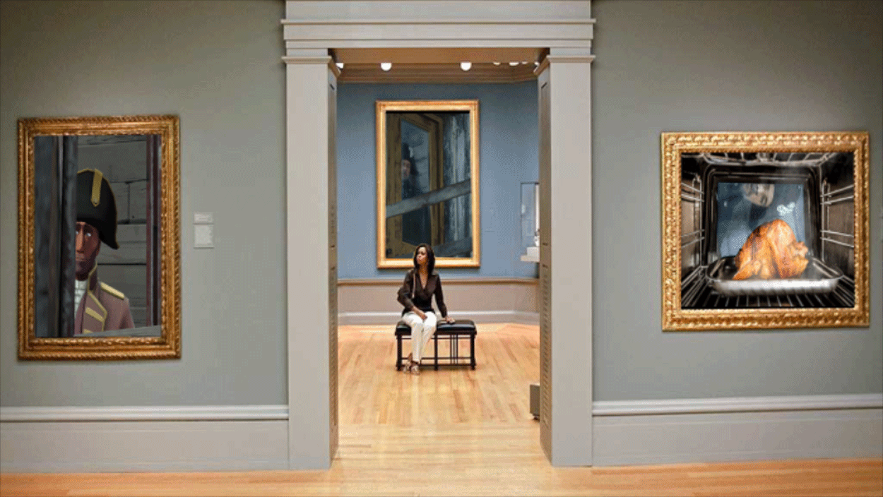
museum

Slide 7

present

Slide 8

LISTEN AND REPEAT

Slide 9
seafood

Slide 10
museum

Slide 11
present

Slide 12

GAME TIME.
Yeah.

Slide 13
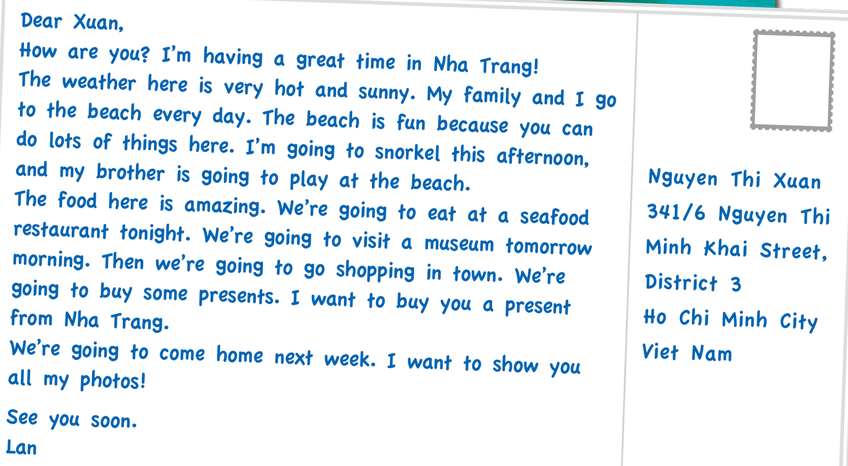

Slide 14
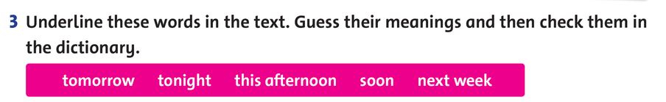

Slide 15

Open your book and read again

Slide 16

GROUPWORK

Slide 17
WHERE IS MY SKATEBOARD?
START

Slide 18

Xuan is having a great time in Nha Trang.
TRUE
FALSE

Slide 19
Xuan and her family go to the beach every day .
TRUE
FALSE

Slide 20
Xuan is going to waterski this afternoon.
TRUE
FALSE

Slide 21
The food in Nha Trang is amazing.
TRUE
FALSE

Slide 22
They’re going to visit the zoo tomorrow morning.
TRUE
FALSE

Slide 23
They aren’t going to go shopping in town tomorrow afternoon.
TRUE
FALSE

Slide 24
Xuan wants to buy Lan a present is Nha Trang.
TRUE
FALSE

Slide 25
They’re going to come home next week.
TRUE
FALSE

Slide 26
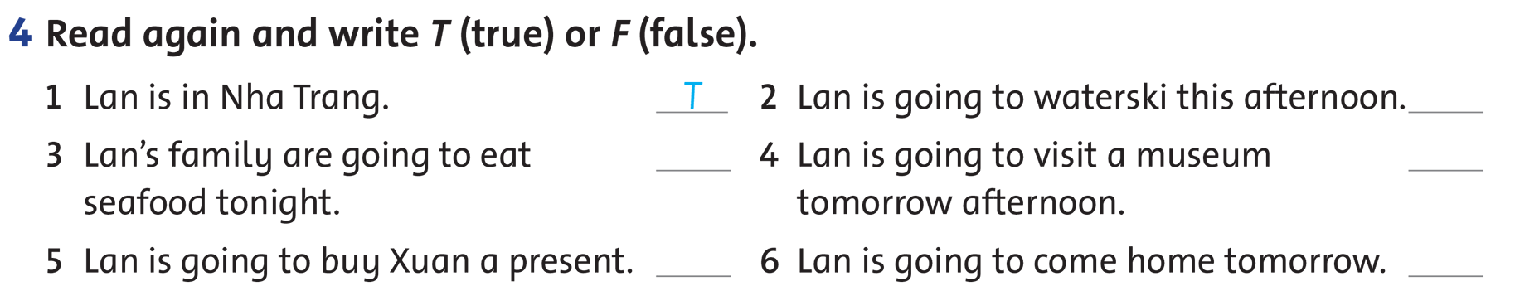

Slide 27

WORKBOOK TIME

Slide 28
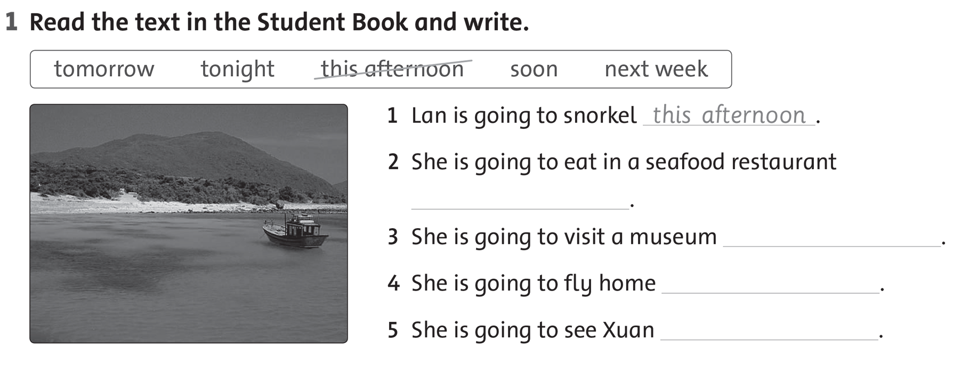

Slide 29
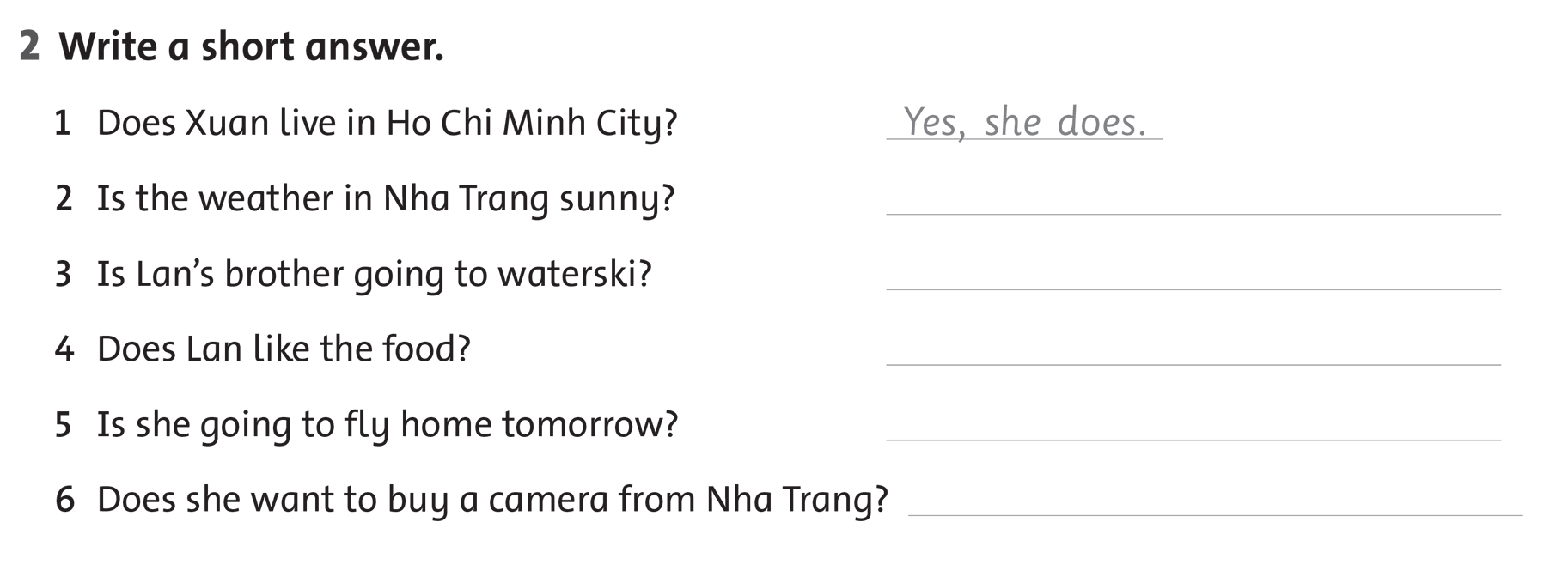

Slide 30
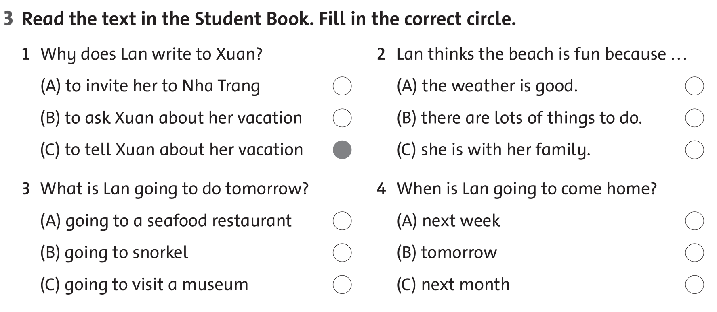

Slide 31

GOODBYE!!!

Slide 32


